Slide 1
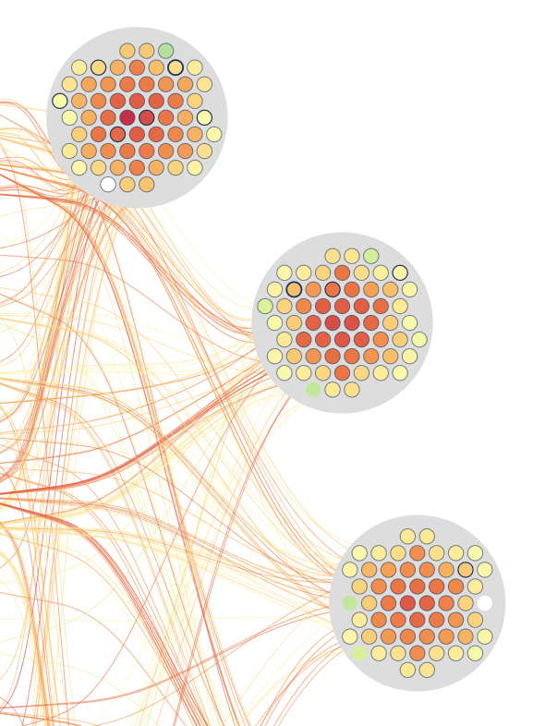
Job monitoring visualization
Weekly report

Slide 2
Content
JobView : job Name display
JobView use case

Slide 3
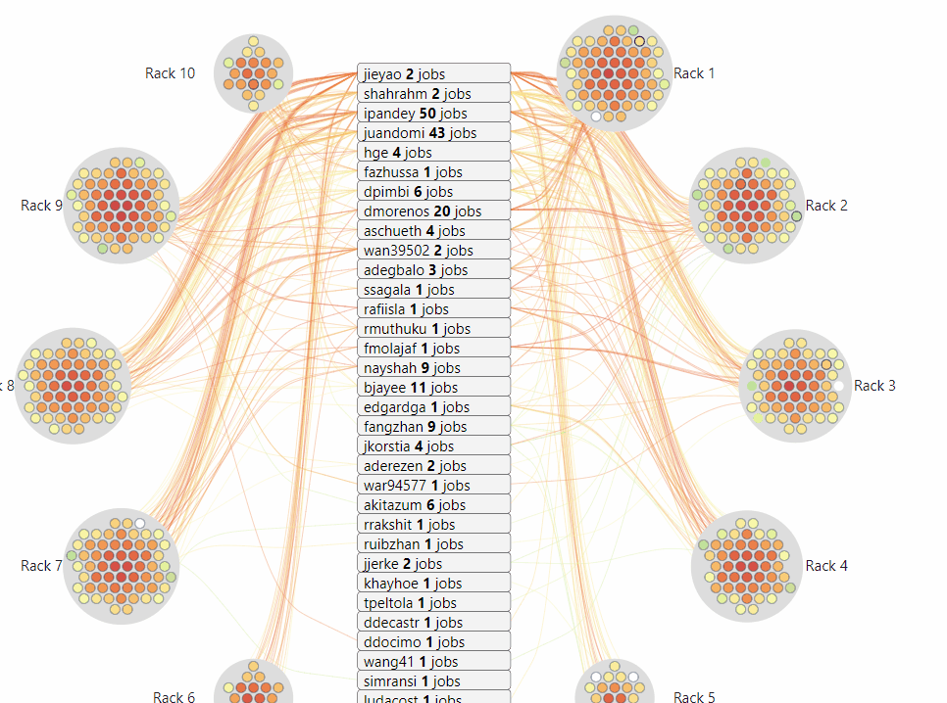
JobViewer
Compute
User
Link
Color by metrics value (e.g: Temperature, Fan speed, etc.)
Border thickness: number of user utilizing the node

Slide 4
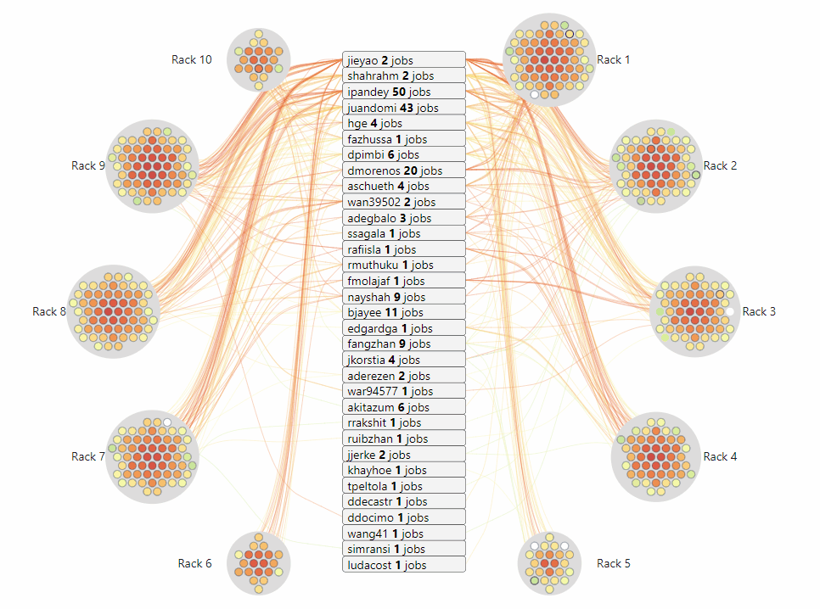
JobViewer
Compute
User
Link
<user_name> <#jobs> jobs
#job: running job the snapshot

Slide 5
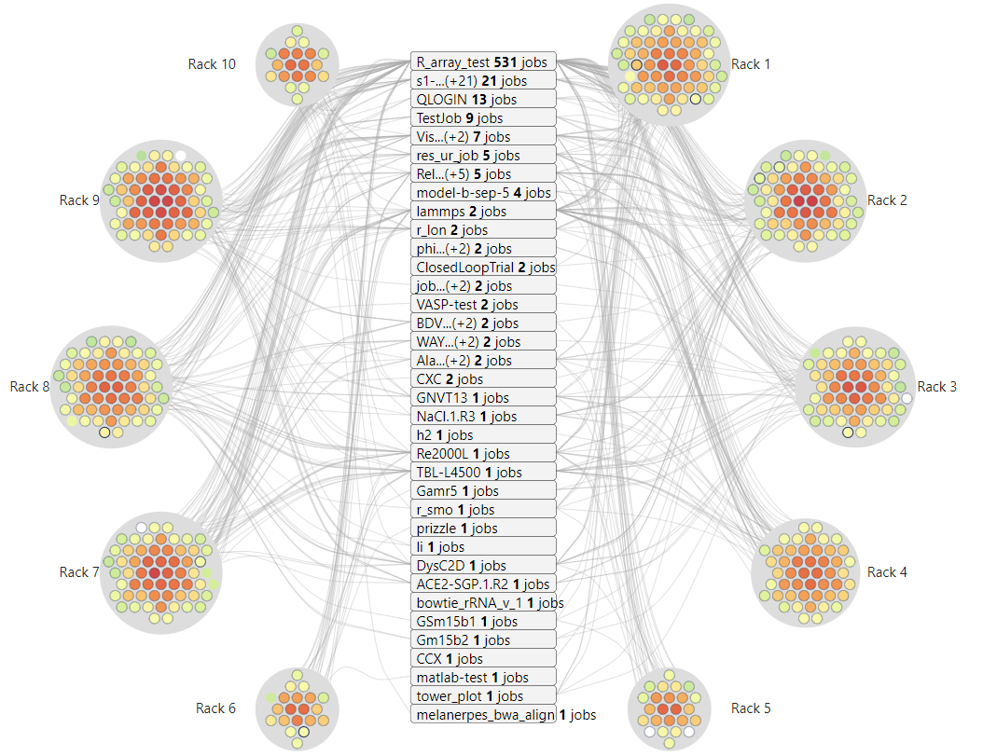
JobViewer
Compute
User
Link
<job_name> <#jobs> jobs
#job: running job the snapshot

Slide 6
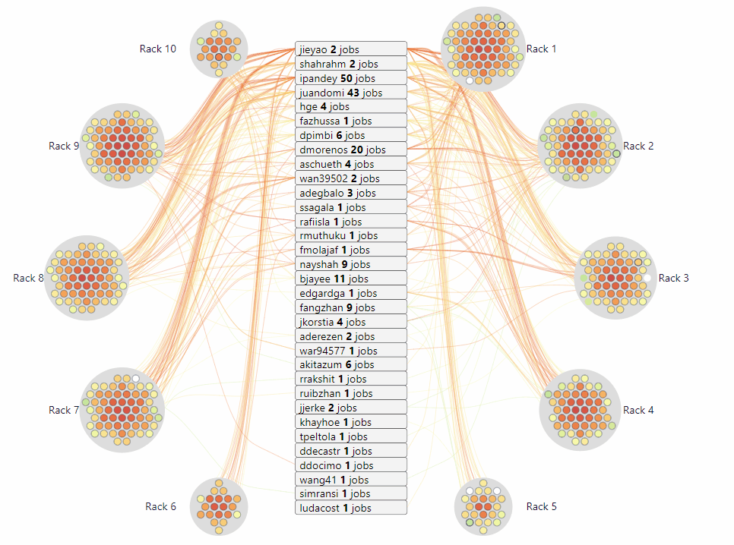
JobViewer
Compute
User
Link
Connect between the user and compute when that user has a running job on that compute

Slide 7
JobViewer
Historical data
https://idatavisualizationlab.github.io/HPCC/jobviewer/index.html
Realtime
https://idatavisualizationlab.github.io/HPCC/jobviewer/index.html?mode=realTime

Slide 8
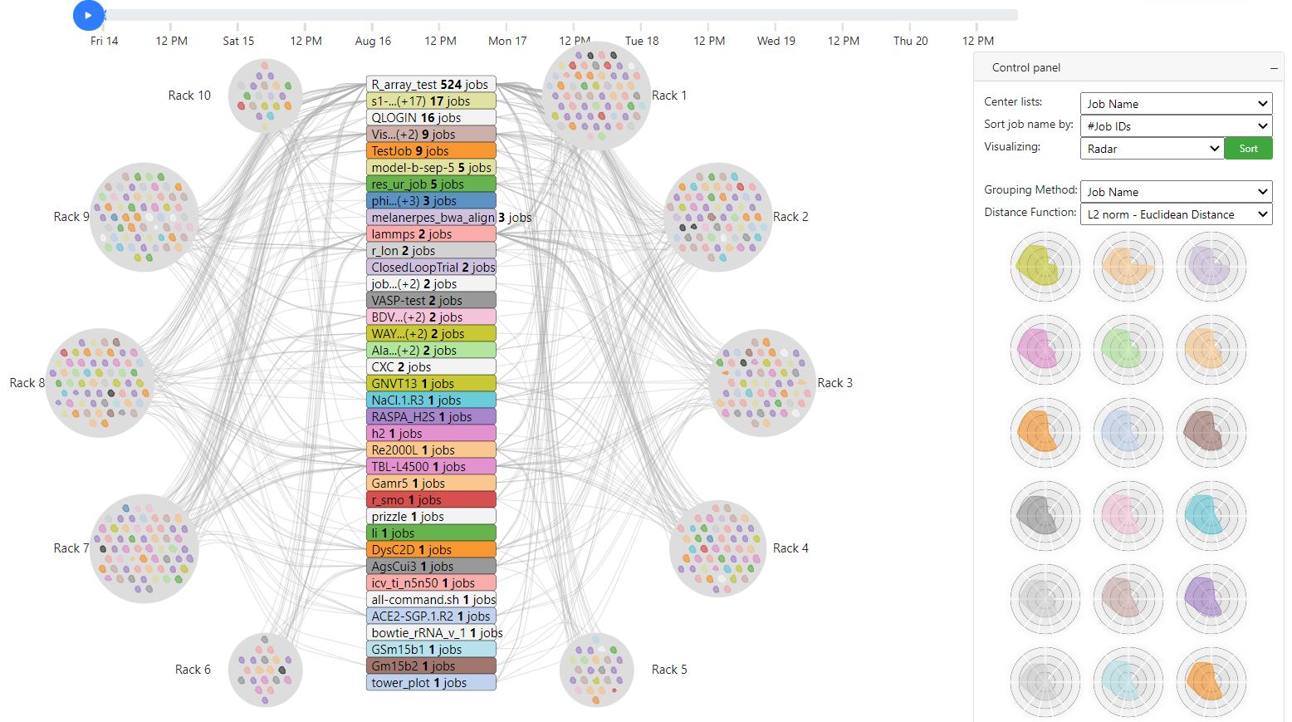
JobViewer
Job characteristic
August 14, 2020 12:00:00 AM
Gamr5

Slide 9
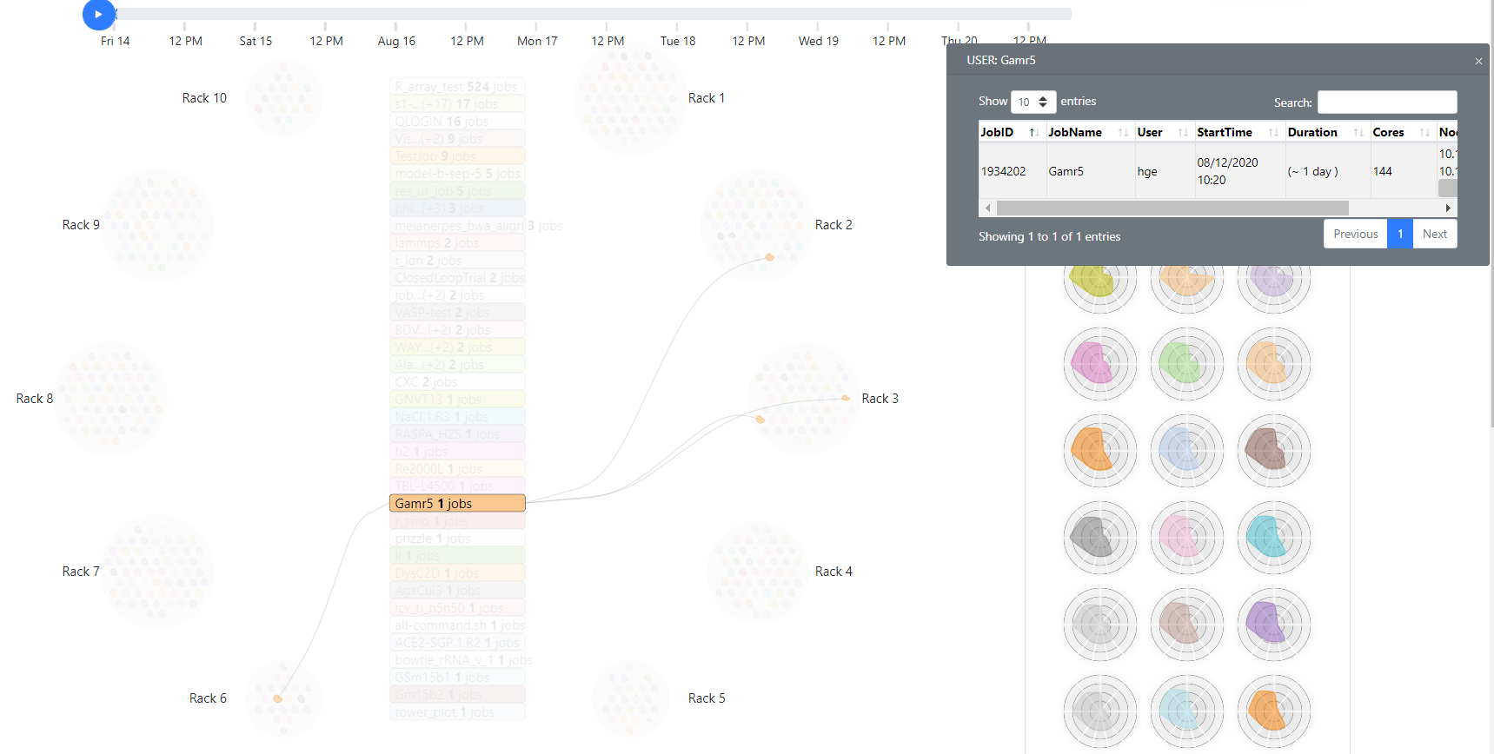
JobViewer
Job characteristic
August 14, 2020 12:00:00 AM

Slide 10
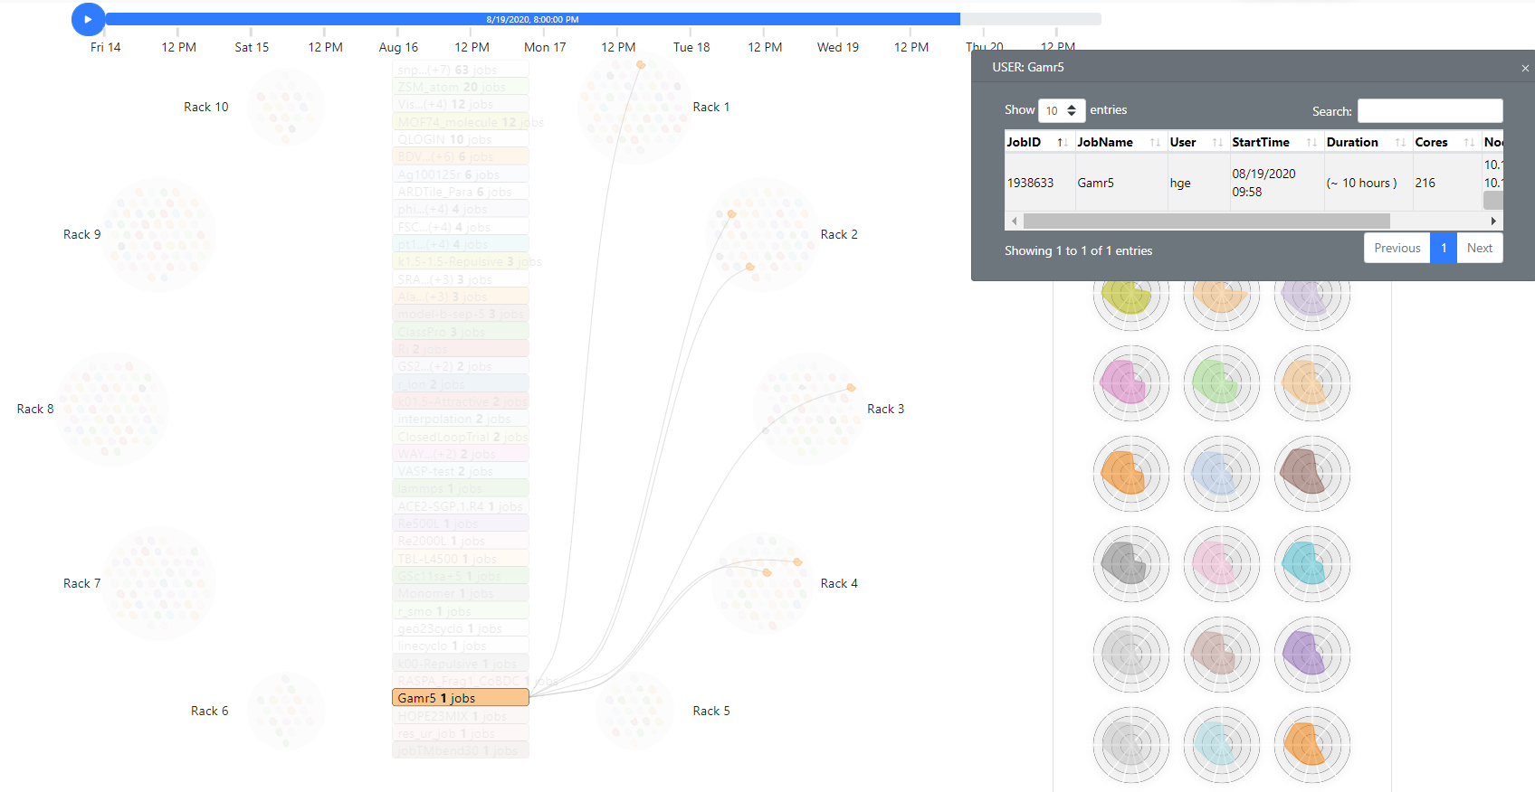
JobViewer
Job characteristic
August 19, 2020 8:00:00 PM

Slide 11
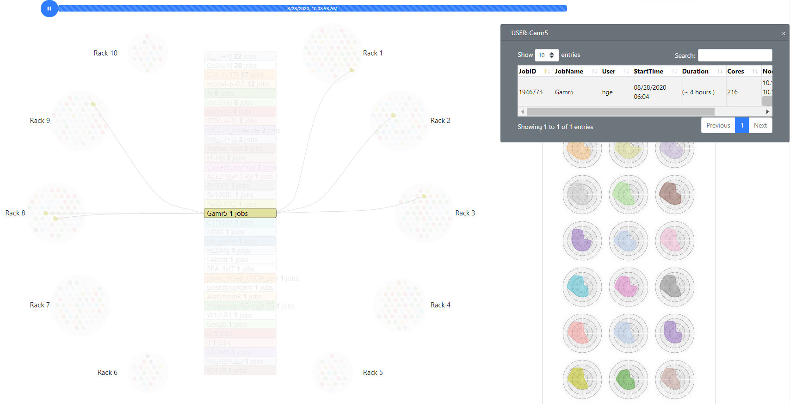
JobViewer
Job characteristic
August 28, 2020 10:08:58 AM

Slide 12
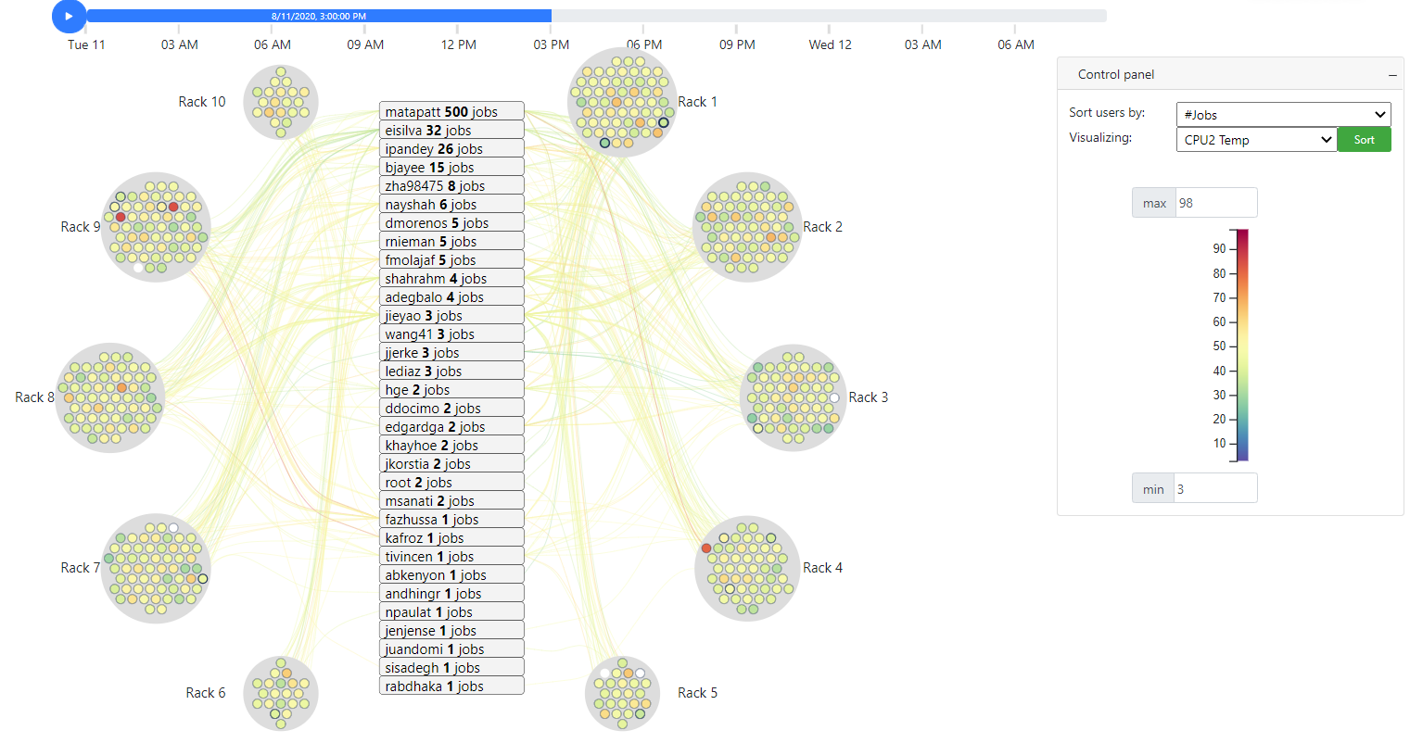
JobViewer
High CPU2 Temperature
August 11, 2020 3:00:00 PM
compute-9-47
compute-9-4
compute-4-33

Slide 13
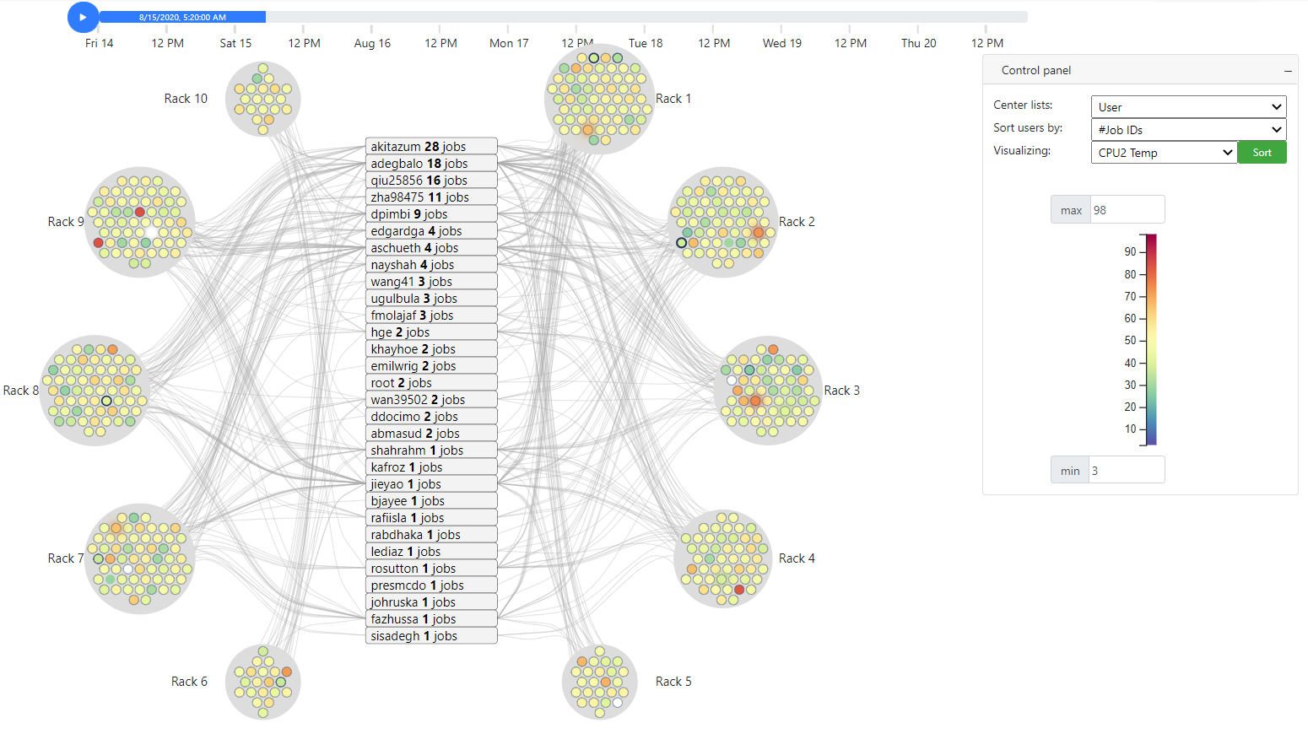
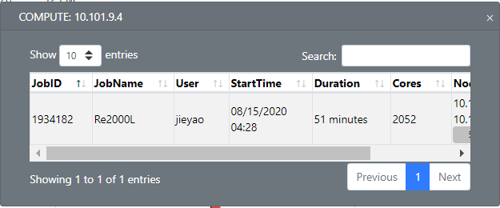

JobViewer
High CPU2 Temperature
August 15, 2020 5:20:00 AM
compute-9-4
compute-9-47
compute-4-33

Slide 14
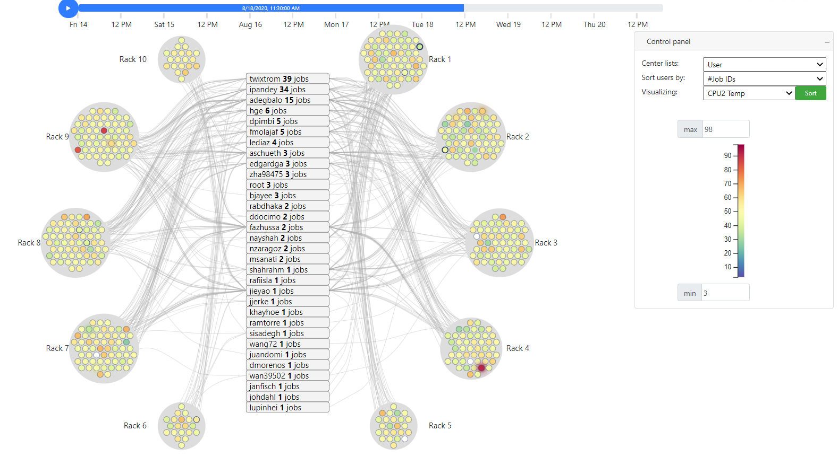


JobViewer
High CPU2 Temperature
August 18, 2020 11:30:00 AM
compute-9-4
compute-9-47
compute-4-33

Slide 15
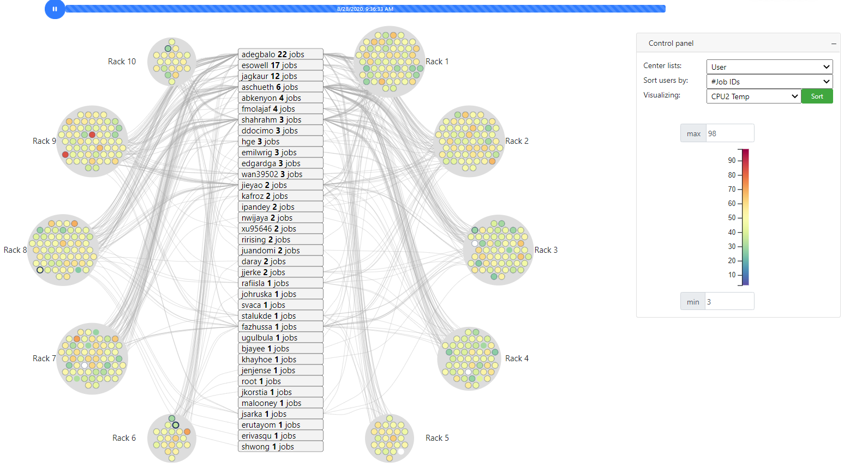
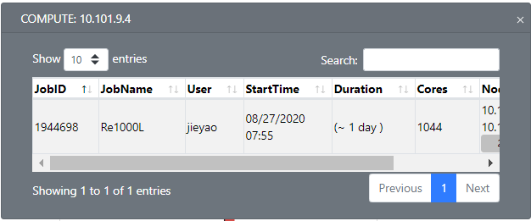
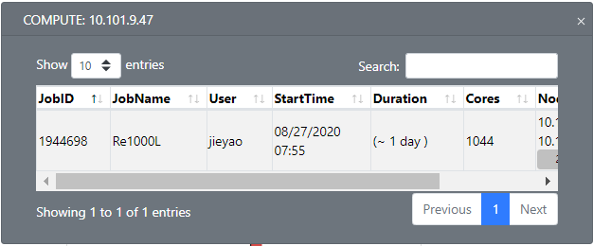
JobViewer
High CPU2 Temperature
August 28, 2020 9:36:33 AM
compute-9-4
compute-9-47
compute-4-33

